Slide 1
Optimizing Charging Station Placement for Electric Vehicles
Group 10: Jingzhen Xie, Lucas Qian, Ruizhe Zhu, Yunqiao Guo, Zhenyu Wang
APAN 5400 Term Project Presentation

Slide 2

Background & Definition
“Roughly 20% of electrical owners in California switched back to gas because charging their cars is a hassle!”
The surge in electric car sales necessitates an optimized charging infrastructure. With limited ranges compared to gasoline vehicles, strategically placed charging stations are vital for convenient long-distance travel and sustained electric vehicle market growth.
Our project aims to develop a search engine that optimizes electric car charging station placement, ensuring convenient and efficient charging for drivers.
The search engine will serve for New York State.

Slide 3

Data Source Specification
Provider | U.S. Department of Energy
Date Created | March 28, 2016
Last Updated | Till Now
Variable Used | Station Name Street Address City Zip Code Station Phone EV Network Connector Types
Our data source from the New York City Open Data
Name as Electric Vehicle Charging Stations in New York
Link: https://data.ny.gov/Energy-Environment/Electric-Vehicle-Charging-Stations-in-New-York/7rrd-248n

Slide 4
Implemented design choices
Retrieving data from an API: We used the Requests module in Python to send GET requests retrieves data from the New York State Electric Vehicle Charging Stations API. This choice allows for up-to-date information and access to a large amount of data without the need for manual input.
Data storage with MongoDB: We used a MongoDB database to store the retrieved data from the API as JSON object. MongoDB is a NoSQL database that offers flexible data storage capabilities and efficient querying, making it a suitable choice for handling large amounts of unstructured data.
Use of HTML templates: We used HTML templates to render search results and display them to the user. Jinja2 is used as the template engine.
Use of regular expressions in search: The search engine allows users to search for charging stations by zip code, city, EV network, and connector types. Regular expressions are used in the search to allow for partial matching of search terms.
Flask web framework: We used the Flask web framework to create a simple web application that allows users to search for EV charging stations based on certain criteria such as city, zip code, EV network and connector types. Flask is a lightweight and modular web framework that allows for easy routing and handling of HTTP requests, making it a good choice for building small-scale web applications.

Slide 5
The rationale for using the selected technologies
Python:
MongoDB:
By using Python, we can fetch the data from the New York City Open Data API and write the data into a JSON file. We can also use python to display essential attributes such as city names and charging station names, and selectively extract the variables we need for our project.
By connecting to a MongoDB database, we can store the JSON data and apply filters to refine our data file. By observing the results, we can use them as a basis for preparing the creation of a search engine.
Flask:
By leveraging Flask in python, we can develop a search engine that allows users to search for EV charging stations in their city by entering zip codes, city names, or EV Networks. This way, they can access the basic information of the charging stations in their search results. To increase user experience, we construct two HTML files for the main page and result page of the search engine.

Slide 6
Data Quality
Accuracy:
Completeness:
Source from U.S. Department of Energy, to assure the accuracy.
Variables ie. zip, address etc. meet our expectation.
Consistency:
Timeliness:
The data keep the same format after each time of API update.
Data that created on March 28, 2016 till now.
Validity:
Licensing:
Government source, API or excel format, can be used in JSON
Opendata

Slide 7
Scalability and Cost Implications
Scalability: These technologies enable horizontal and vertical scalability to handle increasing amounts of data and users as the electric vehicle market grows.
Cost Implications:
Item | Annual Cost (USD) | Description
Server Infrastructure | 3,000 | Ongoing server maintenance and upgrades for cloud-based servers.
Software Licensing | 0 | We used open APIs
Developer Salaries | 160,000 | Combined annual salaries for a small team of 2 full-time junior engineer (1 months)- 2 x 40 hrs/week x 4 weeks x $50/hr = 160,000
Maintenance & Support | 20,000 | Ongoing costs for bug fixes, feature updates, and user support.

Slide 8
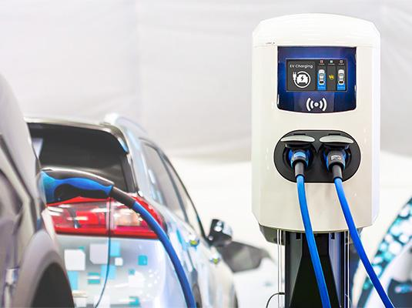
Conclusion for Electric Vehicles
Overall, the development of a charging pile search engine is a significant step forward in the adoption of EVs. It helps to address a key challenge for trolley users and provides a more convenient and efficient way to locate charging stations. With its scalability, the search engine can continue to support the growing demand for EVs and help to make electric transportation more accessible to people around the world.

Slide 9
Recommendation for Electric Vehicles
1. Continuous data update
To help car owners locate charging piles, it's important to have accurate and up-to-date information about the location of charging stations. We would recommend integrate longitude and latitude to maps data, provides a precise location for each charging stations.
Provide information for real-time utilization rate, allows user to access charging station based on the usage rate of each charging points.
2. User feedback integration
Based on the density and customers' feedback on the number of EV charging stations, we can suggest that electric vehicle manufacturers request they build more EV stations to fulfill customers' usage.
Based on customers' feedback, we can add more search filters and options for our search engine, such as adding features with current station passenger flows to create convenience for customers.

Slide 10
Thanks For Listening!
Notes:
Continuous data update: To help car owners locate charging piles, it's important to have accurate and up-to-date information about the location of charging stations. This can be achieved by leveraging real-time data sources such as GPS trackers on charging stations, crowd-sourced information from users, and data from electric vehicle manufacturers. By continuously updating the data and making it easily accessible through a mobile app or website, car owners can quickly find charging stations and plan their routes accordingly.
User feedback integration: Collaborating with electric vehicle manufacturers to gather feedback on user experiences can provide valuable insights into how to improve the charging experience. This can include feedback on the usability of charging stations, the reliability of the charging process, and overall customer satisfaction. This information can be used to improve the design and functionality of charging stations, as well as the overall user experience.
Expansion to emerging markets: As the demand for electric vehicles continues to grow, expanding into emerging markets can provide new opportunities for growth. However, it's important to understand the unique challenges and needs of these markets. This may include adapting to different cultural norms and regulations, as well as developing partnerships with local companies and organizations. By taking a strategic and culturally sensitive approach, companies can successfully expand into new markets and increase their market share.

